Slide 1


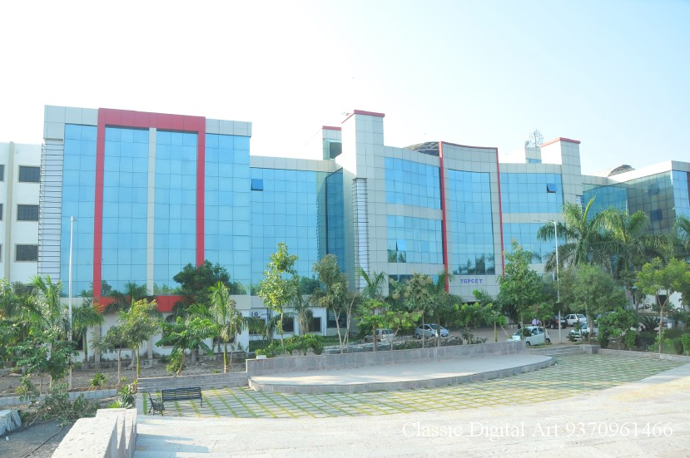
Presentation on
“Soil Classification Using Machine Learning Methods and Crop Suggestion Based on Soil Series”
BY
Komal Ambagade
Vidya Tulaskar
Rita Dhoble
Divya Bawane
Sanjana Virmuttu
B.E CSE SEM VII
Session 2022-23

Slide 2
Index
Introduction
Literature Survey
Existing Model
Proposed Model
Software and Hardware Requirements
Expected Result
Conclusion
Future Scope
References

Slide 3
Introduction
About 70% of the Indian population is dependent on agriculture, making it an agricultural nation. Agriculture is considered as the prime pulse of the Indian economy and is at the core of development of the nation.
Agriculture accounts for nearly 19% of the GDP and about 66% of the population is dependent on the sector. Farmers till now had adopted conventional farming techniques.
Digital farming helps to increase productivity by precisely determining the steps that need to be practiced at its due season. Predicting the weather conditions, analyzing the type of soil, recommendation of the crops, fertilizers are some of the features of digital farming.

Slide 4
Introduction
Soil Classification involves grouping soils based on their physical, chemical and biological factors. Machine Learning techniques have been significantly applied to classify soil based on different soil properties like appearance, organic matter, soil texture etc.
The proposed work helps to identify types of soil, recommends suitable crops on that soil type and fertilizers, water supply required for that crop, and temperature. The work uses popular algorithms like CNN and SVM for classifying the soil. CNN classified the soil with an accuracy of 91%. SVM was able to record an accuracy of 73%.

Slide 5
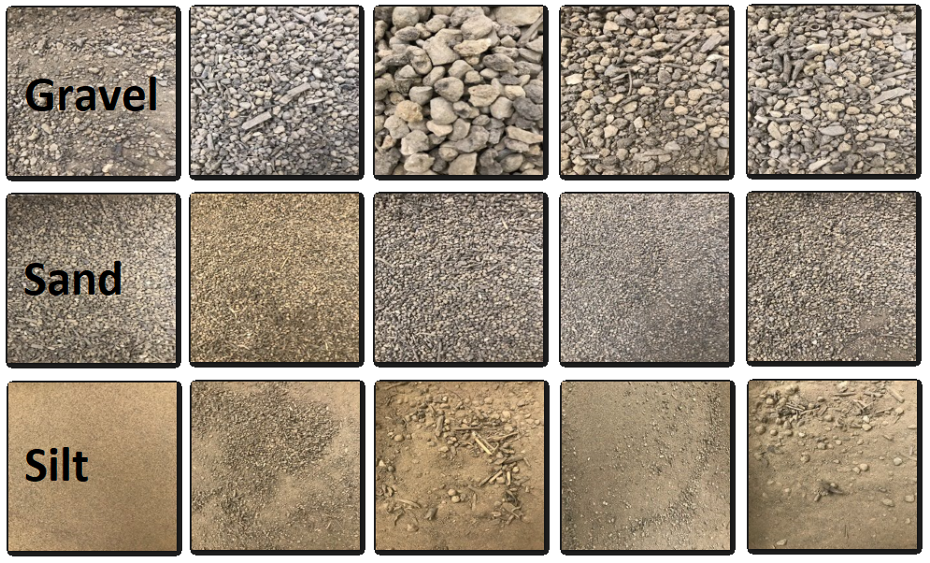
Soil Types

Slide 6
Literature Survey
Sr. No. | Title of the Paper | Authors | Year/ISSN No./Volume Number | Proposed Concept and Details
1 | Soil Classification And Crop Suggestion Using Machine Learning Algorithm | Snehal Mule , Prof.Mandar Sohani | www.jetir.org (ISSN-2349-5162) | A GUI is developed in Python to suggest a crop which can be grown in farm according to condition of farm. Geometric progression algorithm is used for predicting crop.
2 | Classification of Soil and Crop Suggestion using Machine Learning Techniques. | Mrs. N. Saranya, Ms. A. Mythili | (IJERT) ISSN: 2278-0181, Vol. 9 Issue 02, February-2020 | Proposed a method for classifying the soil according to the macro nutrients and micro nutrients and predicting the type of crop that can be cultivate in that particular soil type.
3 | Soil Classification And Crop Suggestion Using Machine Learning | Shravani V, Uday Kiran, Yashaswini J, and Priyanka D | p-ISSN: 2395-0072, https://www.irjet.net/ | The project aims at creating a model that efficiently classifies the soil instances and map the soil type to the crop data to get better prediction with higher accuracies.

Slide 7
Problem Statement
Crop’s productivity is mainly based on the type of soil. The possible way to improve productivity is that we choose a right crop for the right land type.
The traditional methods are Costly, long process and also time consuming.
Hence, there is a need for new technologies and methods to enhance the existing system in order to get faster and better results.

Slide 8
Objectives
The main objective behind the proposed is to facilitate the farmers and common public to predict what kind of crops can be grown for different types of soil series based on agricultural data analysis using machine learning techniques and image processing. And also suggest which crop should be grown in a particular season.

Slide 9
Existing System
Soil Classification concerns the grouping of soils with a similar range of properties (chemical, physical and biological) into units that can be geo-referenced and mapped. Soils are a very complex natural resource, much more so than air and water.
Early soil classification systems (Russian, USDA 1938) focused on the environment and the soil forming factors to classify soils in zonal soils (in which the pedogenesis was mainly determined by climate and vegetation) and azonal and intrazonal (in which pedogenesis was mainly determined by parent material and time of development).

Slide 10
Existing System
In ancient times, soils used to be classified into twro main groups – Urvara and Usara, which were fertile and sterile, respectively. In the 16th century A.D., soils were classified on the basis of their inherent characteristics and external features such as texture, colour, slope of land and moisture content in the soil. Based on texture, main soil types were identified as sandy, clayey, silty and loamy, etc. On the basis of colour, they wrere red, yellow, black, etc.

Slide 11
Proposed System
The model that is built in this project uses the image of the soil and then informs its type. It also informs the user about the characteristics of the soil, suitable crops, fertilizer etc.
There are three parts of this system.
Dataset
Model
User Interface
Dataset:
The dataset which we have used to train this model consists of nearly 150 images of 7 different soil types. These soils are Red soil, Arid Soil, Alluvial Soil, Black Soil, Laterite Soil, Yellow Soil and Mountain Soil. These images are taken from various sites of the internet
2. Model
The model we built to tackle the classification problems uses the CNN algorithm.

Slide 12
Proposed System
3. User Interface
The user interface used in this model is written in python using the tkinter library.
The proposed work has used Convolutional Neural Network for the classification of different types of soil. The aim of the proposed system is to guide the farmers to maximize the crop yield as well as suggest the most profitable crop for the specific region. Crop yield will subsequently help to meet the increasing demand for the country's food supplies. The proposed work also helps in suggesting the crops based on the soil types, and the fertilizers that can be used, temperature and water required for that crop.

Slide 13
Proposed System
3. DATASET COLLECTION:
The dataset used in the work is created by collecting various images of different types of soil from the google. The dataset consists of images of 7 different soil types.
The soil types are:
Red Soil
Arid Soil
Alluvial Soil
Black Soil
Laterite Soil
Yellow Soil
Mountain Soil

Slide 14
Proposed System
Recommendation. The proposed work is a web application using the PyCharm IDE.
Module 1: Soil Classification
In this module, we will classify the soil based on the color, soil texture, types of soil particles etc. using Convolutional Neural Network and Support Vector Machine.
Module 2: Crop Recommendation
Crop Suggestion: Based on the type of soil predicted by the CNN model, the region where the soil is found is predicted. The regions where the soil is found help to predict the crops that are found according to the type and region of the soil.

Slide 15
Proposed System
Module 3: Fertilizer Recommendation
Fertilizer Recommendation: The fertilizer is recommended based on soil prediction. The fertilizer is recommended on the basis of the soil texture, and characteristics of the predicted soil type.
Building the GUI: The website for predicting the soil type and suggesting the crops is made in this module with the help of Tkinter

Slide 16
Requirements
Software Requirements:
Python
Pycharm
Anaconda Navigator
Hardware Requirements:
Laptop / PC
RAM: 4GB (min) 8GB(max)
OS: Windows

Slide 17

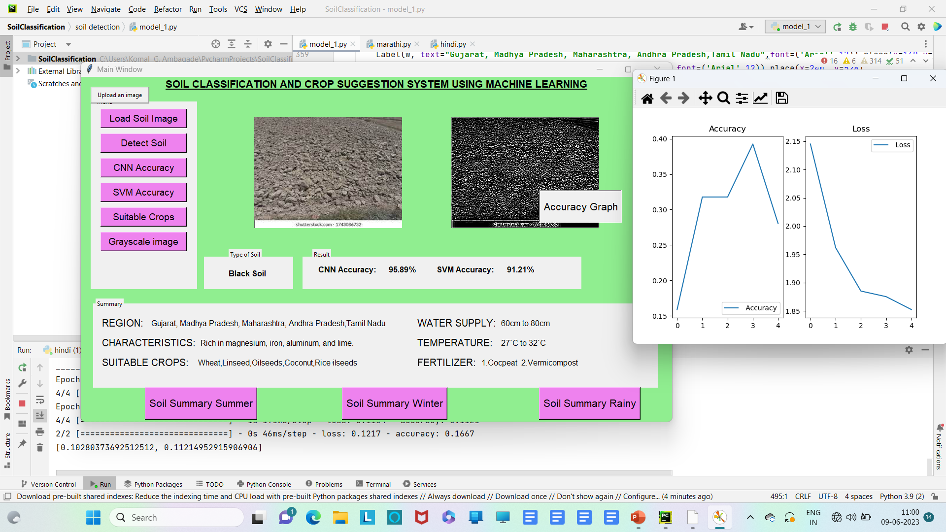

Slide 18
Conclusion
The proposed model aims to help farmers by identifying the type of soil, suggesting plants that grow on that soil, the fertilizer suitable for that soil type, the water supply and the temperature required for that plant. The Soil Classification and Crop Suggestion Project is a valuable tool for farmers to optimize crop yields and improve agricultural practices. By analyzing soil properties such as texture, fertility and pH, farmers can classify their soils into different types and determine the appropriate crop for their land. The proposed model involves the use of data analysis techniques, including machine learning (deep learning) algorithms, to provide accurate soil classification and cropping suggestions. The results of the project can help farmers make informed decisions about their cropping practices and increase their agricultural productivity.

Slide 19
Future Scope
The model proposed in this project can be further extended in the future to incorporate a feature to predict crop rotations, crop demand and supply, and other economic indicators like retail prices, and harvest prices, and we can also show the schemes of the government which are made for farmers. This would provide a holistic prediction not only on the basis of environmental and geographical factors but also depending on the economic aspects.

Slide 20
References
Snehal Mule, Prof. Mandar Sohani Soil Classification And Crop Suggestion Using Machine Learning Algorithm, Jetir April 2020, Volume 7, Issue 4 Www.Jetir.Org (ISSN-2349-5162)
Mrs. N. Saranya, Ms. A. Mythili, Classification of Soil and Crop Suggestion using Machine Learning Techniques, International Journal of Engineering Research & Technology (IJERT), ISSN: 2278-0181, Vol. 9 Issue 02, February-2020
Shravani V, Uday Kiran S, Yashaswini J S, and Priyanka D, Soil Classification And Crop Suggestion Using Machine Learning, e-ISSN: 2395-0056 Volume: 07 Issue: 06, June 2020 www.irjet.net p-ISSN: 2395-0072

Slide 21
References
N. Saranya , A. Mythili, 2020, Classification of Soil and Crop Suggestion using Machine Learning Techniques, INTERNATIONAL JOURNAL OF ENGINEERING RESEARCH & TECHNOLOGY (IJERT) Volume 09, Issue 02 (February 2020).
S. A. Z. Rahman, K. Chandra Mitra and S. M. Mohidul Islam, "Soil Classification Using Machine Learning Methods and Crop Suggestion Based on Soil Series," 2018 21st International Conference of Computer and Information Technology (ICCIT), 2018, pp. 1-4, doi: 10.1109/ICCITECHN.2018.8631943.

Slide 22
Thank You

